Slide 1


ESSAY STRUCTURE
NAS Art History and Theory
Molly Duggins
Academic English Coordinator

Slide 2

Essay planning and structure
Developing a thesis statement
Structuring your argument
Essay plan worksheet
Essay question:
Is photography an art, a science, or something else? Analyse photography’s new role in nineteenth-century art and culture by focusing on two key photographs.
  .

Slide 3
Developing a Thesis Statement
A thesis statement is a summary of your argument that appears at the end of your introduction.
A good thesis has two parts. It should tell what you plan to argue, and it should briefly explain how you plan to argue, via your chosen case studies and the specific points you will make about them.
  .

Slide 4
Developing a Thesis Statement
Your choice of artworks should be identified by artist name, title and date in the thesis statement.
Your thesis will take time to formulate. It is the product of your research and interpretation of your case studies. You may need to revise and rewrite your thesis as your ideas develop.
  .

Slide 5
Thesis Statement Example
Essay question:
Is photography an art, a science, or something else? Analyse photography’s new role in nineteenth-century art and culture by focusing on two key photographs.
Thesis statement:
Nineteenth-century photography was a medium of artistic expression and a powerful scientific tool. Photographers Julia Margaret Cameron and Eadweard Muybridge both experimented with its technology to explore its potential in art and science. While Cameron played with light and focus to create a strikingly aesthetic composition in The Mountain Nymph, Sweet Liberty, 1866, Muybridge utilised rapid exposure to document human and animal motion in his series, Horses. Running, 1879.
  .

Slide 6
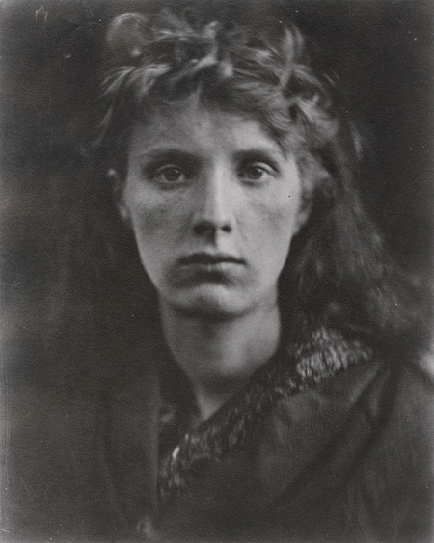
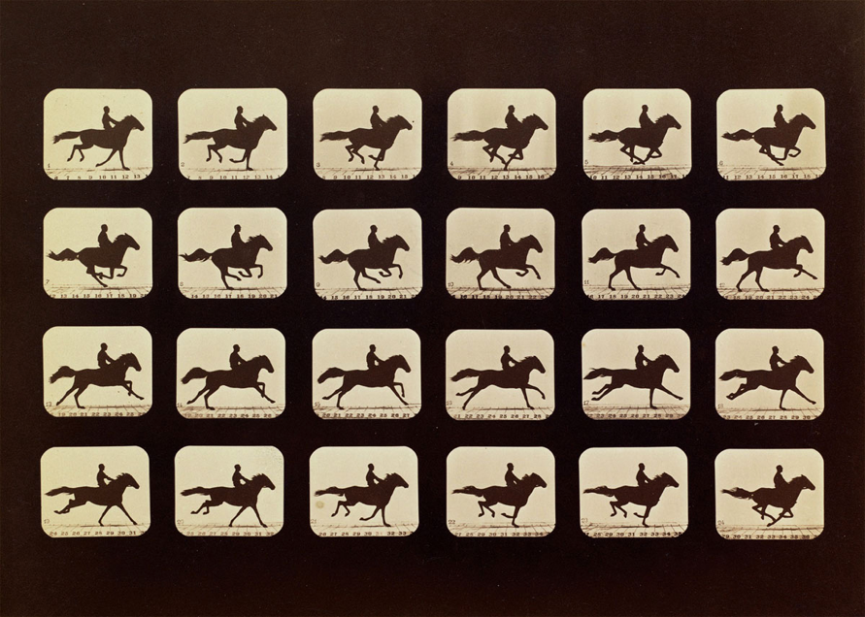
Thesis Statement
What: Nineteenth-century photography was a medium of artistic expression and a powerful scientific tool. Photographers Julia Margaret Cameron and Eadweard Muybridge both experimented with its technology to explore its potential in art and science.
How: While Cameron played with light and focus to create a strikingly aesthetic composition in The Mountain Nymph, Sweet Liberty, 1866, Muybridge utilised rapid exposure to document human and animal motion in his series, Horses. Running, 1879.
  .

Slide 7
Structuring your argument: Shared Context
1. Introduction (about 150 words)
2. Context (about 300 words)
3. Analysis of artwork 1 (about 600 words)
4. Analysis of artwork 2 (about 600 words)
5. Conclusion (about 150 words)

Slide 8
Structuring your argument: Shared Context
1. Introduction ( about 150 words)
Open with a statement that responds to the question, e.g. "Photography in the nineteenth century challenged existing modes of representation and the boundaries between art and science". Present your thesis statement, identify your artwork case studies and briefly explain how they support your argument.
2. Background (about 300 words)
This is the relevant historical, cultural, social or philosophical background to your argument. Make this very specific to the topic of your essay (e.g. Arguments made for the artistic and/or scientific uses of photography in the nineteenth century). This is a good place to discuss primary sources that define key ideas that you will use to analyse your case studies.
CONTEXT > ARTWORKS
ARTWORKS < CONTEXT

Slide 9
Structuring your argument: Shared Context cont.
3. Artwork 1 (about 600 words)
Analysis of subject, form and historical context in relation to your argument. Focus on developing at least 3 key points.
*****strong linking sentence*****
4. Artwork 2 (about 600 words)
Analysis of subject, form and historical context in relation to your argument. Focus on developing at least 3 key points that help you to make your argument, comparing and contrasting them with the points you made in relation to artwork 1.
5. Conclusion (about 150 words)
Bring your essay to a close by discussing how your case studies support different aspects of your argument. Rather than re-stating your thesis, explain how your findings contribute to a more nuanced understanding of your essay topic
  .

Slide 10
Structuring your argument: Different Contexts
1. Introduction (about 200 words)
Open with a statement that responds to the question, e.g. "Photography in the nineteenth century challenged existing modes of representation and the boundaries between art and science". Present your thesis statement, identify your artwork case studies and briefly explain how they support your argument.
2. Artwork 1 (about 700 words)
Analysis of subject, form and historical context in relation to your argument. Focus on developing at least 3 key points that help you build your argument.
3. Artwork 2 (about 700 words)
Analysis of subject, form and historical context in relation to your argument. Focus on developing at least 3 key points, comparing and contrasting them with the points you made in relation to artwork 1.
4. Conclusion (about 200 words)
Bring your essay to a close by discussing how your case studies support different aspects of your argument. Rather than re-stating your thesis, explain how your findings contribute to a more nuanced understanding of your essay topic.
  .

Slide 11
Essay plan worksheet
Question chosen:
Artworks you will focus on (choose two):
[Artist, Title, date, medium, dimensions (in cm), location (collection and city)]
Outline your argument
What are the main issues you want to consider? How do these artworks relate to the question?
Key points relating to artwork 1 (start with the earlier artwork)
What makes the subject of the artwork relevant to your argument?
Which formal qualities support your argument? Try to come up with three key formal qualities that you can make the focus of your analysis.
Which aspects of its historical context are relevant to your thesis? Will you use them to explain the formal qualities of the artwork as you analyse it, or place them in a context paragraph after your introduction?
Which areas or issues need more research?
Where will you look for more scholarly material?
  .

Slide 12
Essay plan worksheet
Key points relating to artwork 2
What makes the subject of the artwork relevant to your argument? Is it the same or different from artwork 1?
Which formal qualities support your argument? How do they differ from those in artwork 1?
Which aspects of the artwork’s historical context will you examine? Are they the same or different from artwork 1? Will you use them to explain the formal qualities of the artwork as you analyse it, or place them in a context paragraph after your introduction?
Which areas or issues need more research? Where will you look for more scholarly material?
Conclusion
How does your analysis of the artworks help us understand the themes outlined in the question?
How do their similarities or differences confirm or nuance your thesis? What do they suggest about the significance of your
topic for art in this period?
  .

